Slide 1


‹#›

Slide 2
Fundamental Concepts
Crystalline: Repeating/periodic array of atoms; each atom bonds to nearest neighbor atoms.
Crystalline structure:
Results in a lattice or three-dimensional arrangement of atoms
Chapter 3: The Structure of Crystalline Solids
‹#›

Slide 3
Unit cells
Smallest repeat unit/entity of a lattice.
Represents symmetry of the crystal structure.
Basic structure unit/building block of crystal structure
Defines the crystal structure by its geometry and atom positions
Co-ordination number
For each atom, it is the number of nearest-neighbors or touching atoms
e.g. FCC:12, HCP:12, BCC:8
Chapter 3: The Structure of Crystalline Solids
‹#›

Slide 4
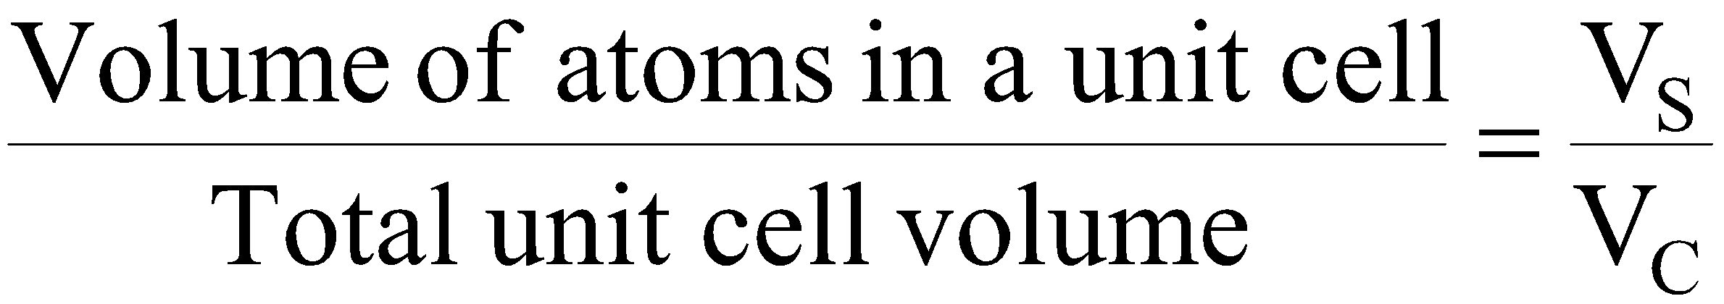
Atomic packing factor (APF):
APF =
= 0.74 (FCC or HCP)
= 0.68 (BCC)
Chapter 3: The Structure of Crystalline Solids
‹#›

Slide 5
Atoms per unit cell
FCC Face atoms= 6 x ½ =3 4
Corners atoms = 8 x 1/8 =1
e.g., Al, Ni, Cu, Au, Ag, Pb, Gamma (γ)-Iron
BCC Body atom=1 2
Corners atoms = 8 x 1/8 =1
e.g., Cr, W, Alpha (α)-Iron, Delta (δ)- Iron, Mo, V, Na
SC Corners atoms = 8 x 1/8 =1 } 1
Chapter 3: The Structure of Crystalline Solids
‹#›

Slide 6
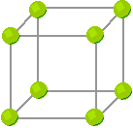
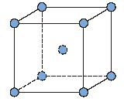
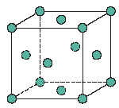
Metallic crystal structure
SC (Simple Cubic)
BCC (Body-Centred Cubic)
FCC (Face Centred Cubic)
Chapter 3: The Structure of Crystalline Solids
‹#›

Slide 7
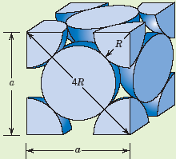
Metallic Crystal Structure continue …….
where, R: Radius of atom
a: cube edge
a² + a² = (4R)²
2a² = (4R)² = 16R²
a = 2R √2
APF=
Chapter 3: The Structure of Crystalline Solids
‹#›

Slide 8
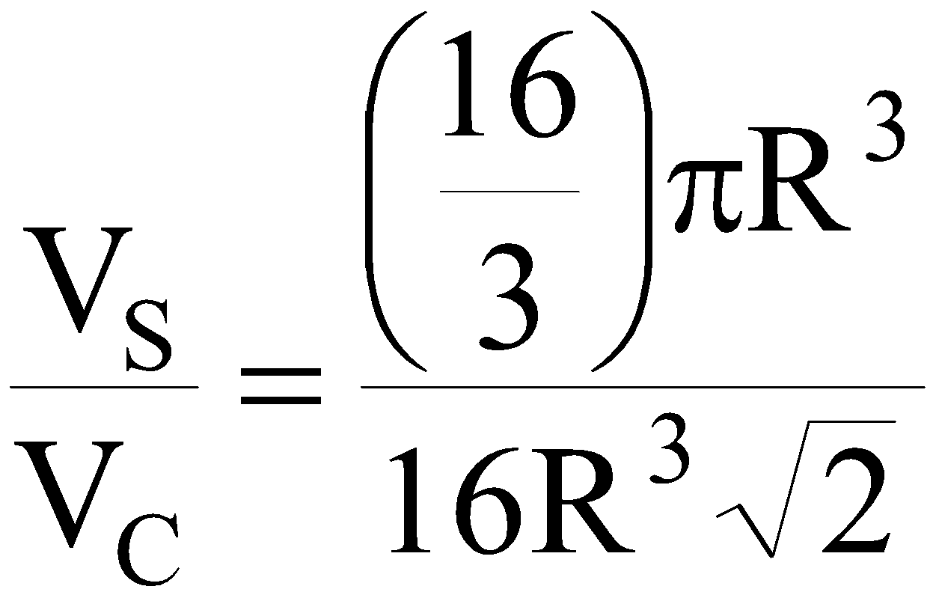
Metallic Crystal Structure continue …….
Unit cell volume = V_{c} = a³
= (2R√2)³ = 16 R³ √2
V_{s} = 4/3 π R³ x 4 4 atoms/unit cell
=16/3 π R³
Total cell volume, V_{c} =16 R³ √2
APF = = 0.74
Chapter 3: The Structure of Crystalline Solids
‹#›

Slide 9
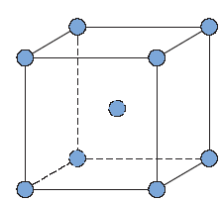
Metallic Crystal Structure continue …….
Body Centered Cubic
All sides are equal to dimension “a” a² + a² = 2a²
(a√2)² + a² = 3a² = (4R)²
a√3= 4R
a√3
a√2
Chapter 3: The Structure of Crystalline Solids
‹#›

Slide 10
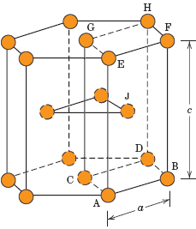
Metallic Crystal Structure continue …….
The Hexagonal Close-Packed
6 Atoms at top 12
6 Atoms at bottom
2 Centre face atoms
3 Midplane atoms
12 x 1/6 = 2
2 x 1/2 = 1 6 atoms/unit cell
Midplane 3
Co-ordinate number: 12 (HCP or FCC)
Atomic packaging factor (APF): 0.74
e.g., Cd, Zn, Mg, Ti
Chapter 3: The Structure of Crystalline Solids
‹#›

Slide 11
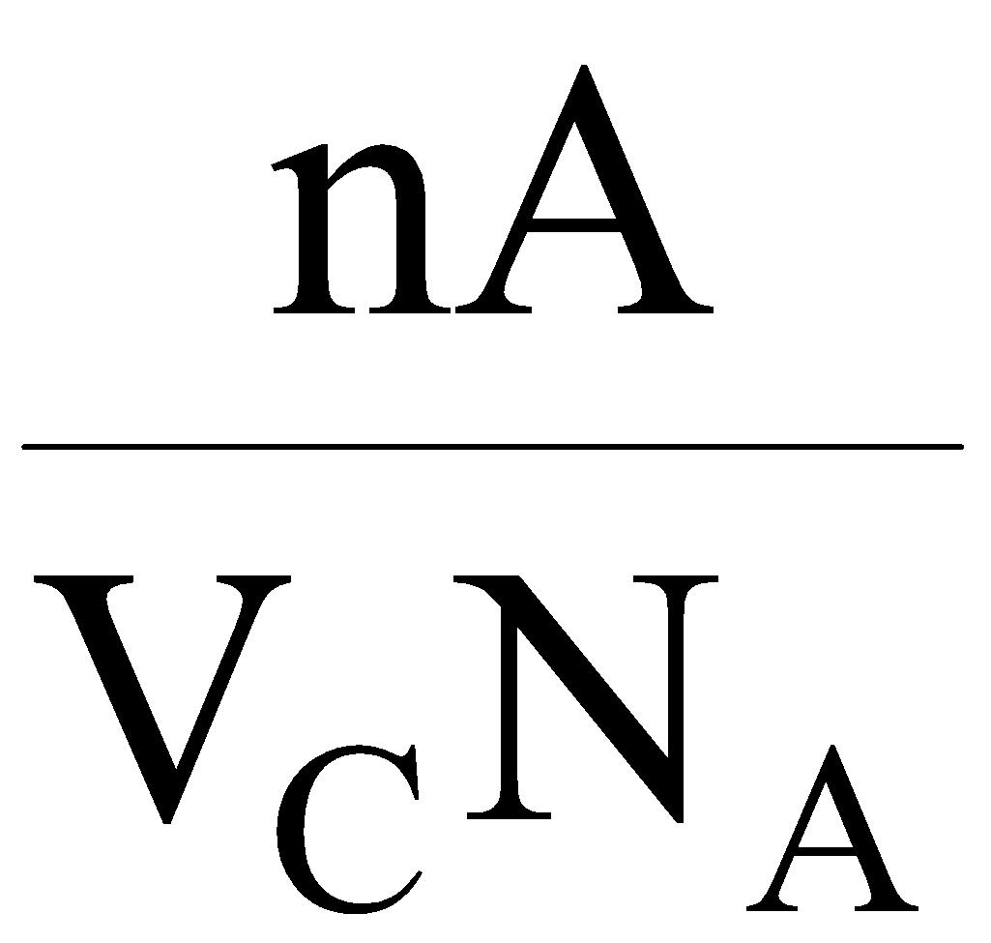
Density Computations
Density, ρ=
n= No. of atoms/unit cell
A= Atomic weight
V_{c}=Volume of unit cell
N_{A}= Avogadro’s number (6.023 x 10²³/mole)
Chapter 3: The Structure of Crystalline Solids
‹#›

Slide 12
Problem:
Copper has an atomic radius of 0.128 nm, an FCC crystal structure, and an atomic weight of 63.5 g/mol. Compute its theoretical density and compare the answer with its measured density.
Given:
Atomic radius = 0.128 nm (1.28 Ǻ)
Atomic weight = 63.5 g/mole
n = 4 A_{CU} = 63.5 g/mol
Chapter 3: The Structure of Crystalline Solids
‹#›

Slide 13
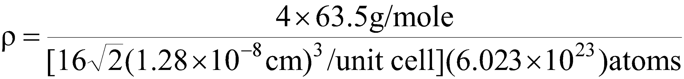
Solution:
Unit cell volume = 16 R³√2
R = Atomic Radius
= 8.89 g/cm³
Close to 8.94 g/cm³ in the literature
Chapter 3: The Structure of Crystalline Solids
‹#›

Slide 14
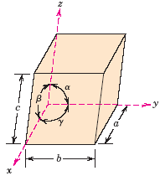
Crystal system
x, y, z : Coordinate systems
a, b, c : Edge lengths
α, β, γ : Inter axial angles
Cubic system: a=b=c α=β=γ=90°
Lattice parameter (e.g., a,b,c, α, β, γ) determine the crystal system. There are seven crystal systems which are Cubic, Tetragonal, Hexagonal, Rhombohedral (Trigonal), Monoclinic, Triclinic.
Chapter 3: The Structure of Crystalline Solids
‹#›

Slide 15
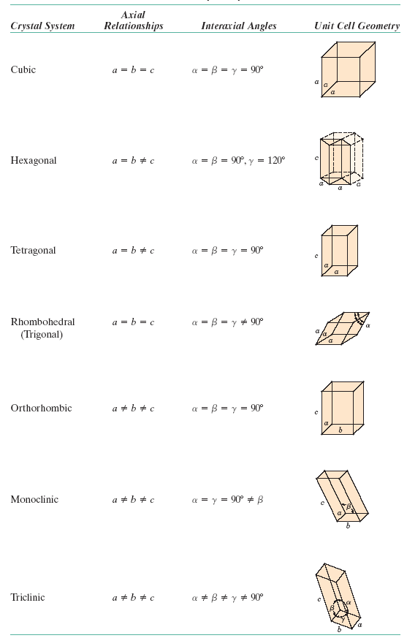
Crystal system
“C” (vertical axis) is elongated
One side not equal
One side not equal
Equal sides
Not at 90°
Three unequal sides
Source: William D. Callister 7th edition , chapter 3 page 47
Chapter 3: The Structure of Crystalline Solids
‹#›

Slide 16
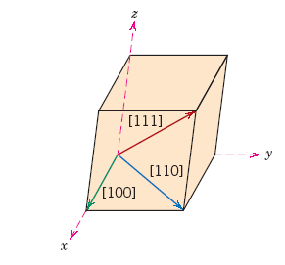
Crystallographic Direction
Steps:
Choose a vector of convenient length
Obtain vector projection on each of three axes (for the direction to be drawn, if necessary)
Divide the three numbers by a common factor (if the indices are to be assigned) to reduce to the smallest integer values
Use square brackets [ ]
Chapter 3: The Structure of Crystalline Solids
‹#›

Slide 17
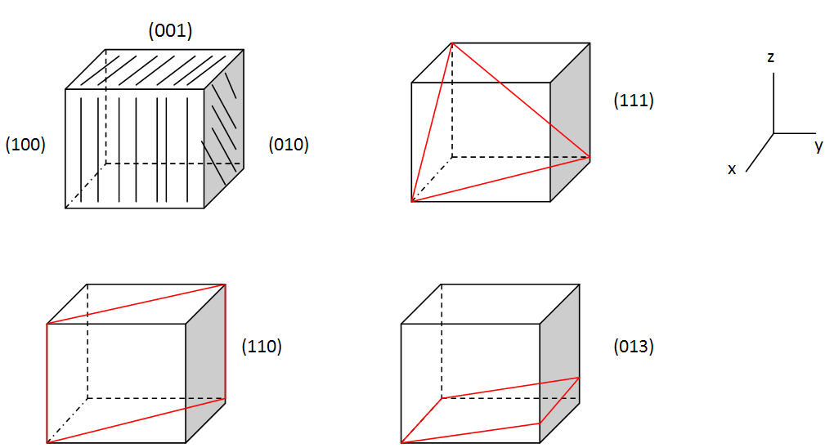
Crystallographic Planes
Miller Indices (hkl)
Chapter 3: The Structure of Crystalline Solids
‹#›

Slide 18
Crystallographic Planes
Steps:
Obtain lengths of planar intercepts for each axis.
Take reciprocals
Change the three numbers into a set of smallest integers (use a common factor )
Enclose within parenthesis e.g., (012)
Tips: 1. Parallel planes have the same indices
2. An index 0(zero) implies the plane is parallel to that axis.
Chapter 3: The Structure of Crystalline Solids
‹#›

Slide 19
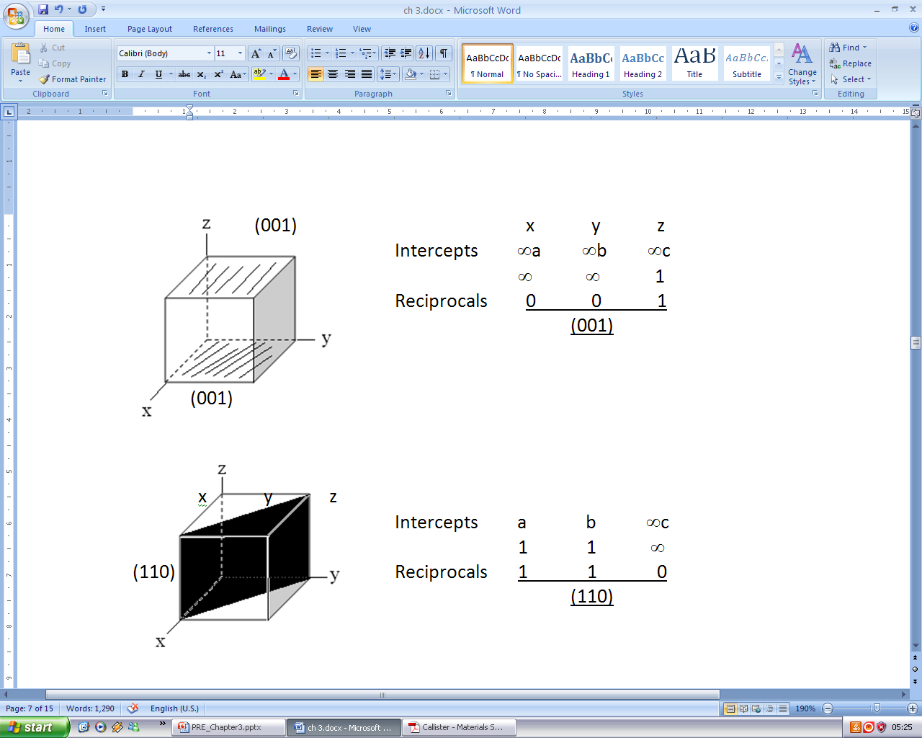
Crystallographic Planes continue.....
Chapter 3: The Structure of Crystalline Solids
‹#›

Slide 20
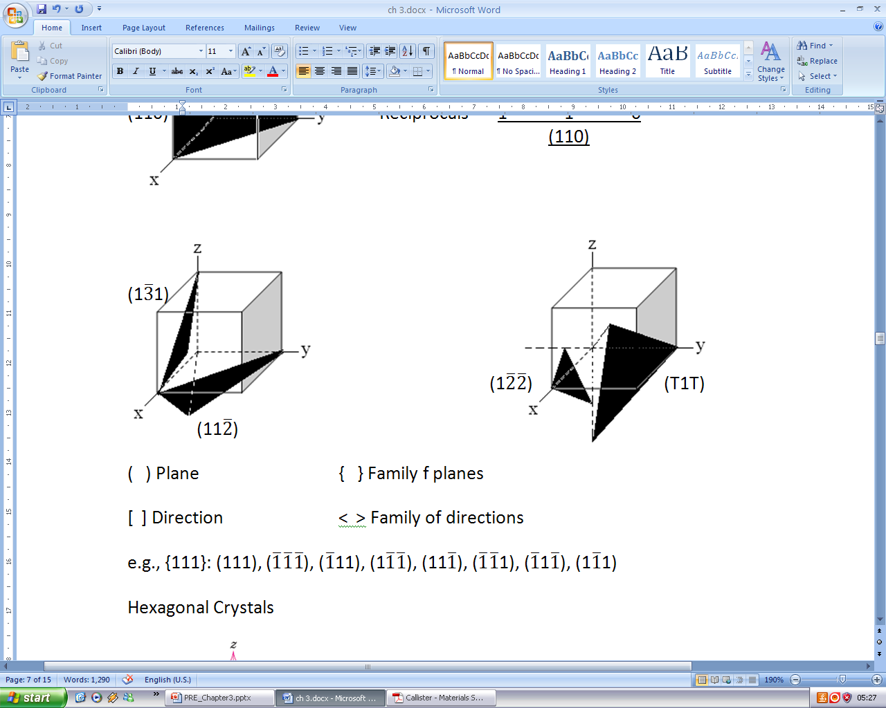
Crystallographic Planes continue.....
Cubic Crystal system
Chapter 3: The Structure of Crystalline Solids
‹#›

Slide 21
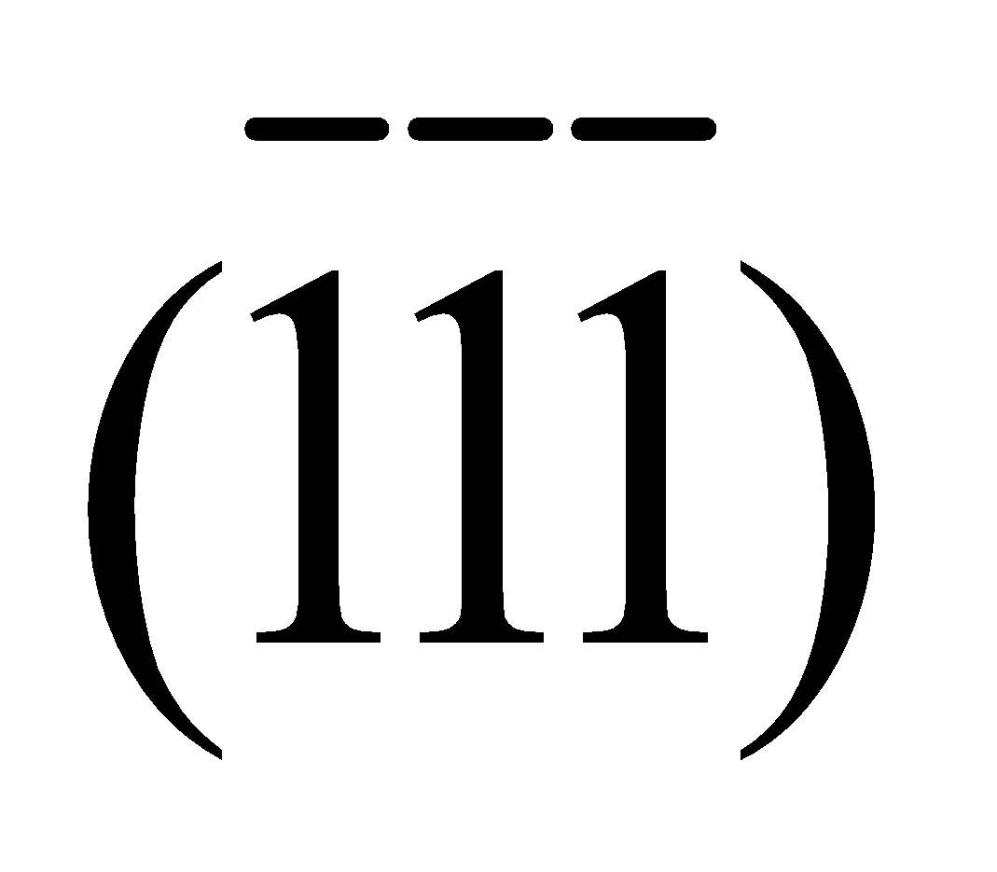
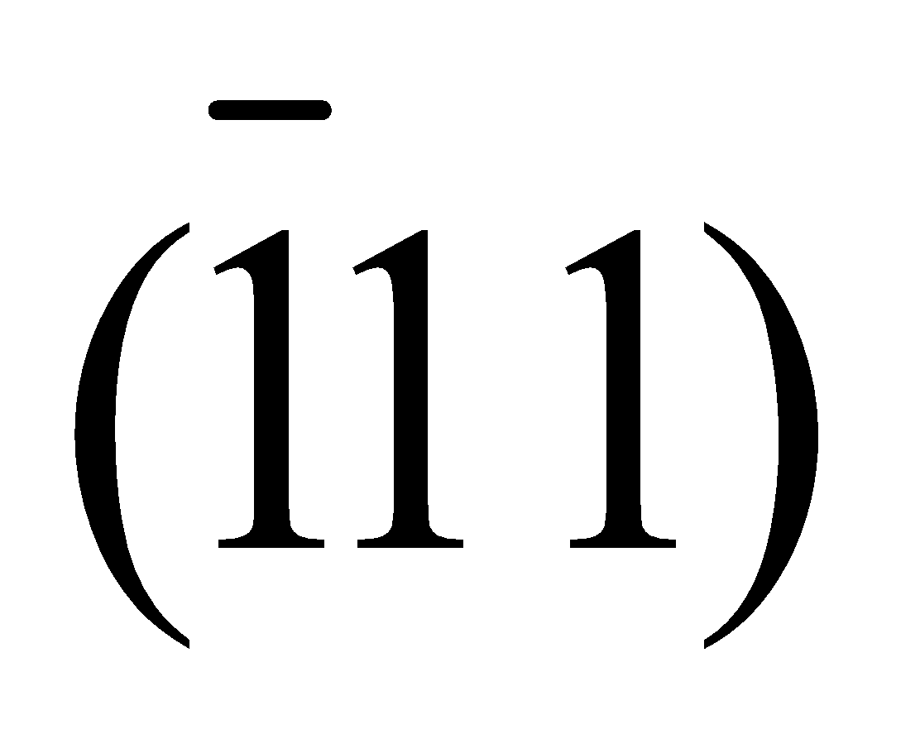
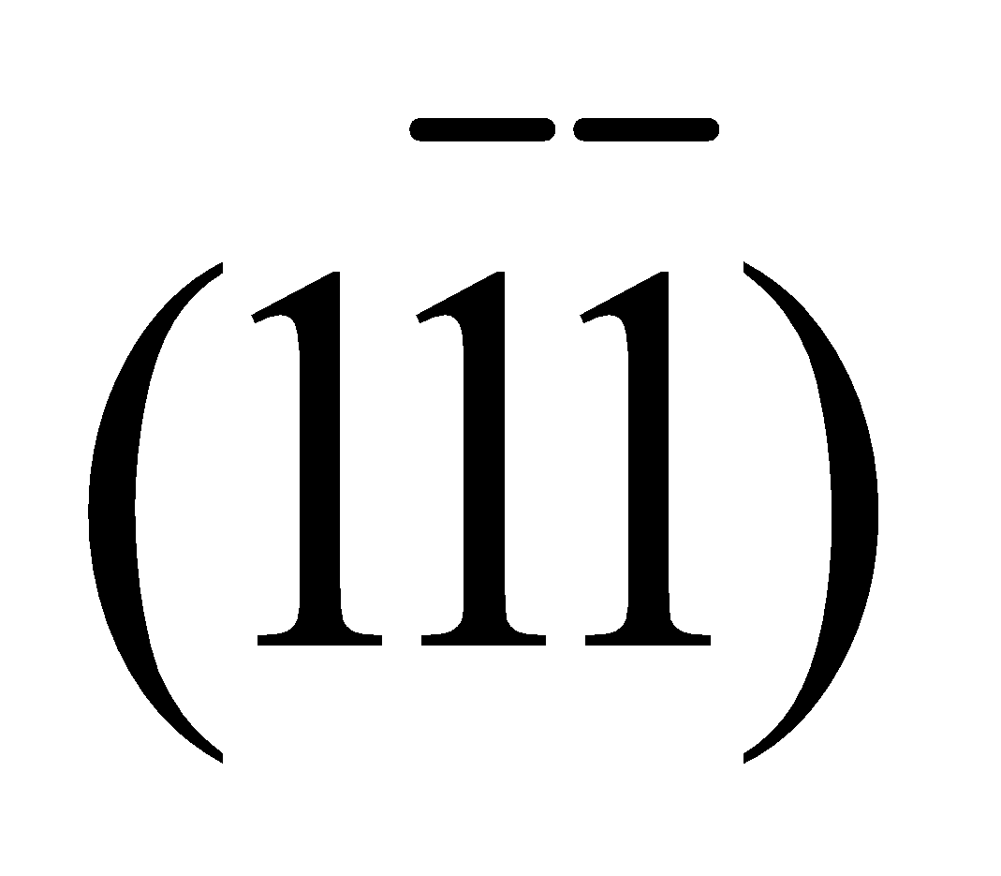
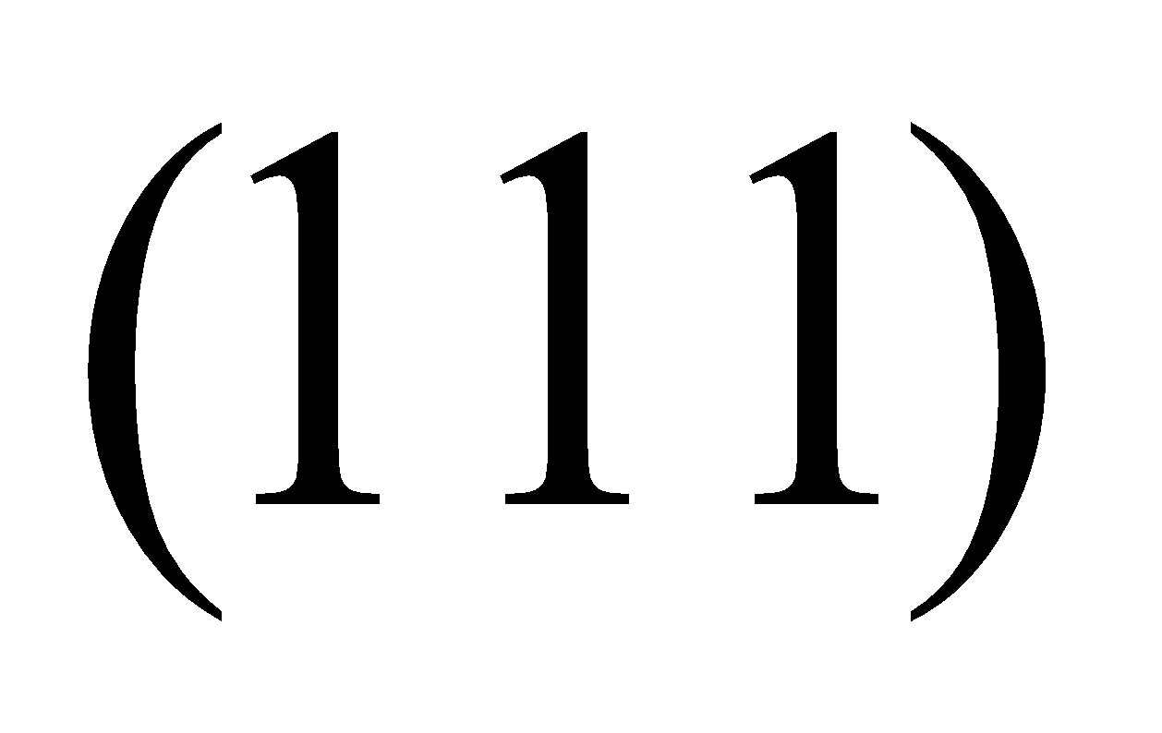
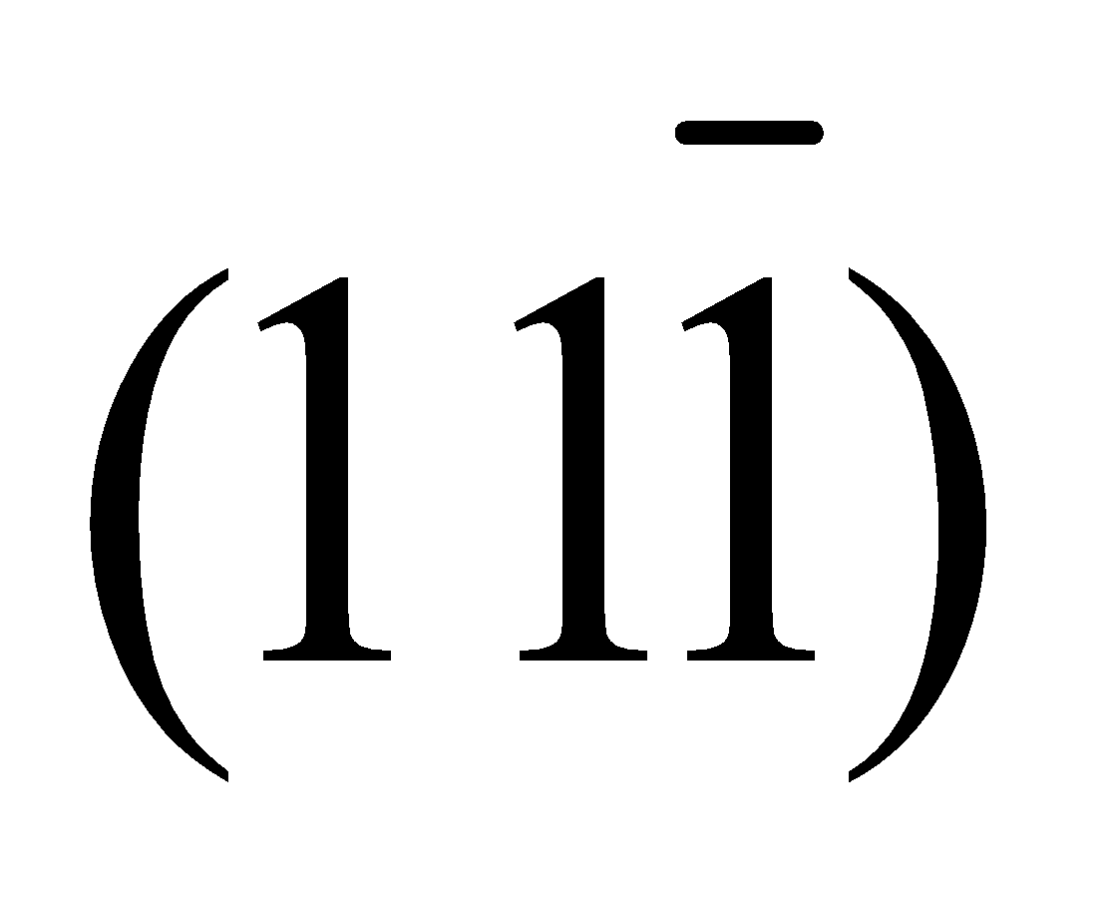
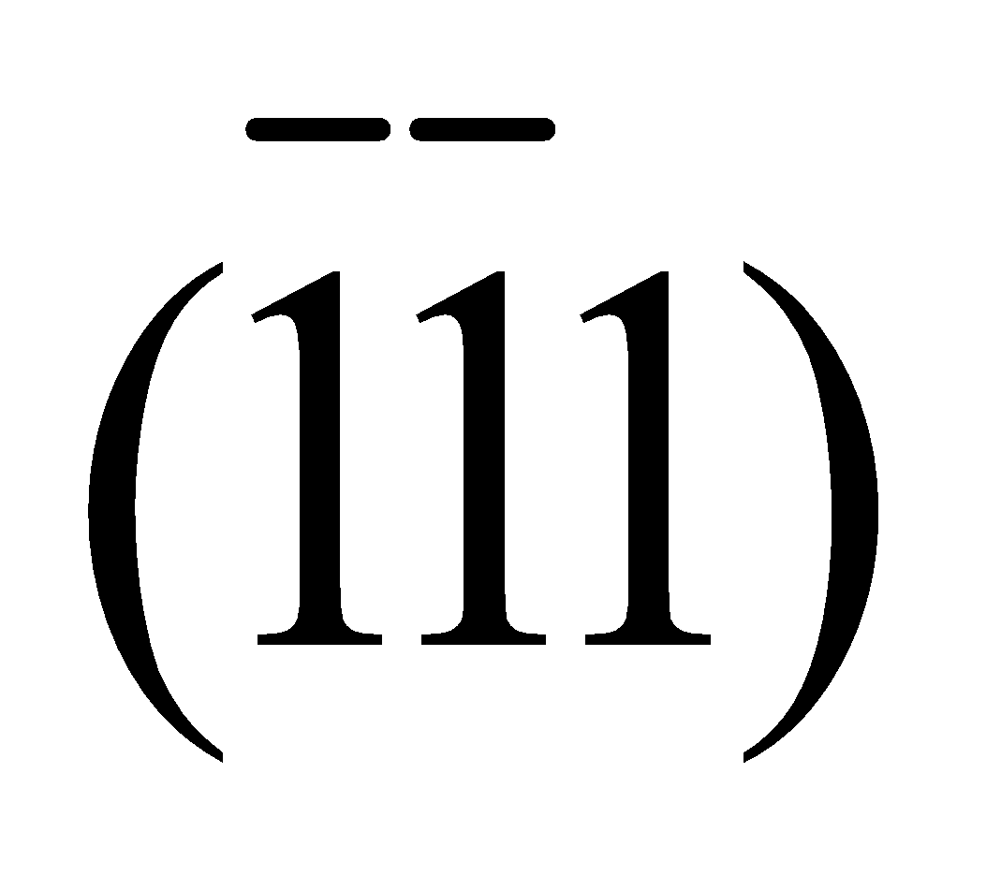
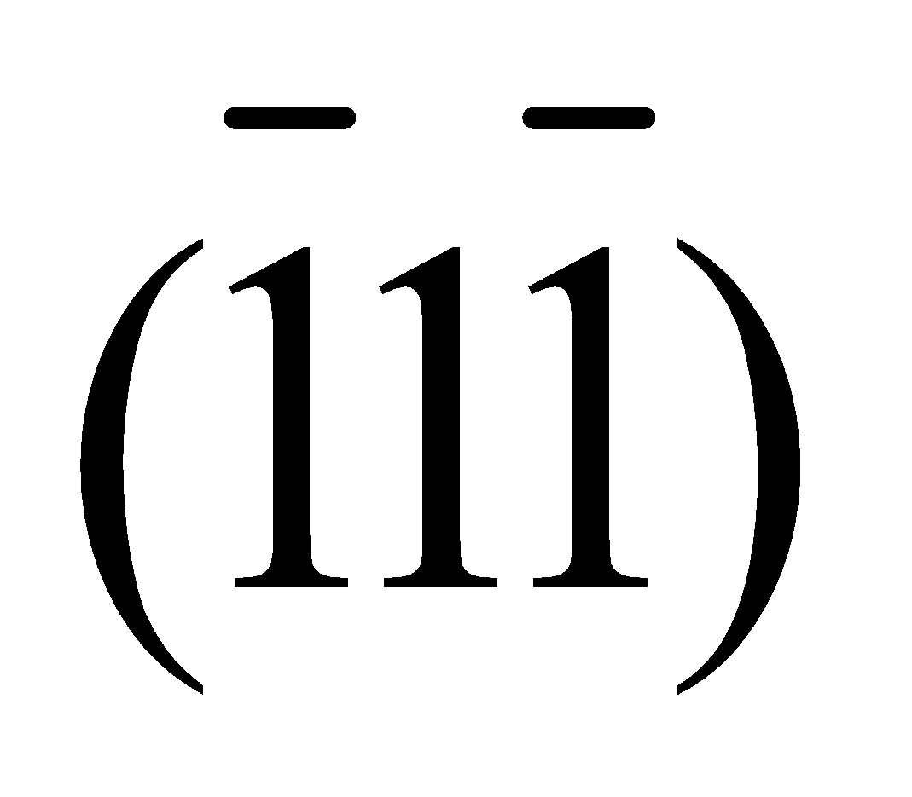
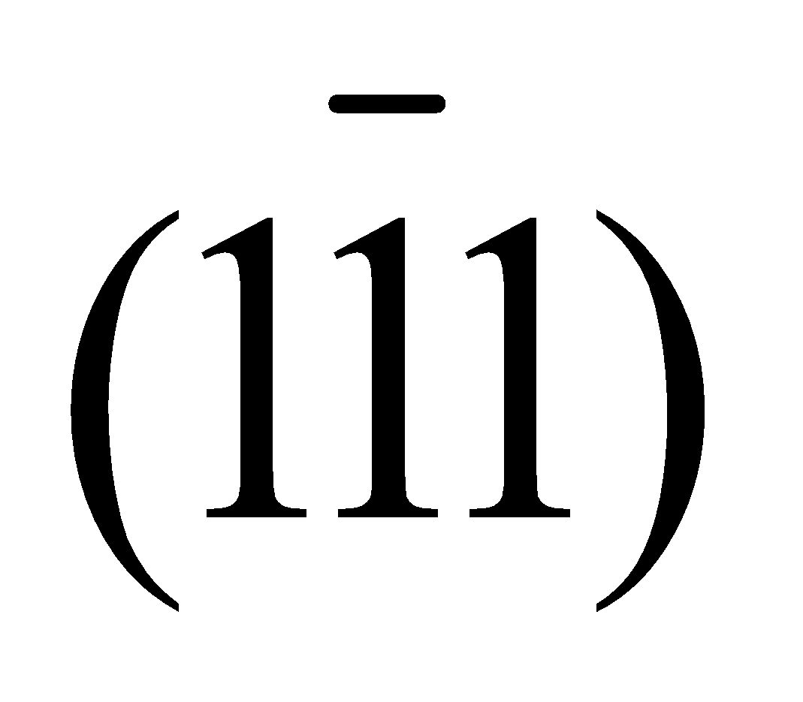
Crystallographic Planes continue.....
Cubic Crystal system
( ) Plane { } Family of planes
[ ] Direction < > Family of directions
e.g., {111}:
Chapter 3: The Structure of Crystalline Solids
‹#›

Slide 22
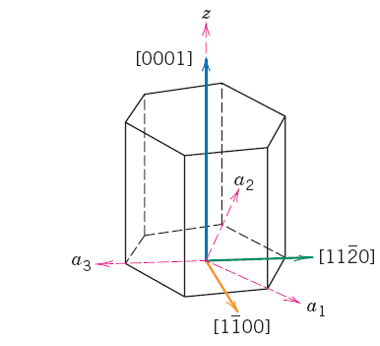
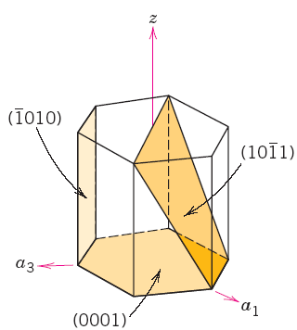
Crystallographic Planes continue.....
Hexagonal Crystal system
Chapter 3: The Structure of Crystalline Solids
‹#›

Slide 23
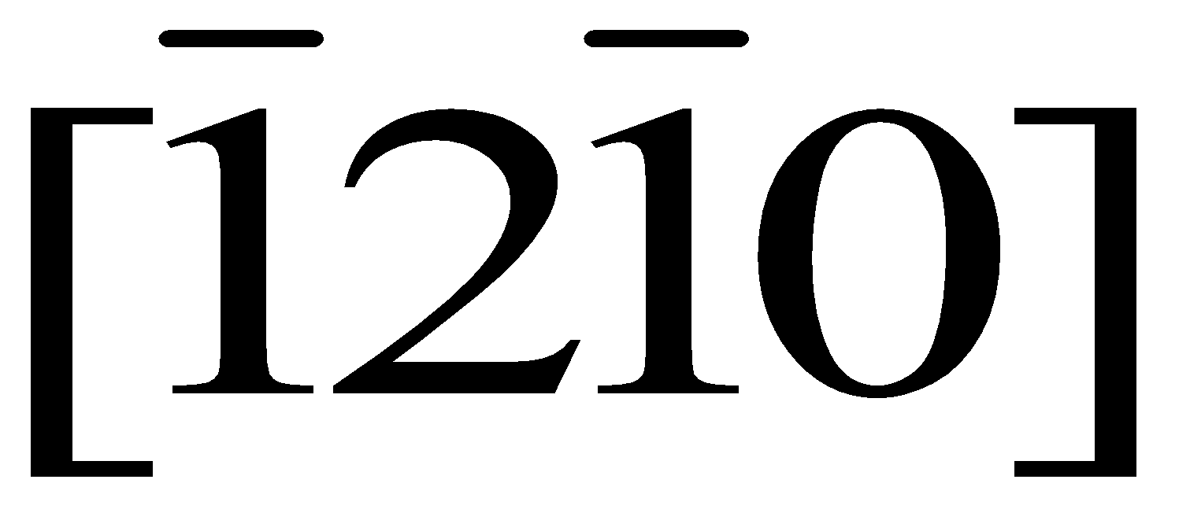

Crystallographic Planes continue.....
Hexagonal Crystal system
[u’v’w’] -------> [u v t w]
[0 1 0] ------->
u = n/3 (2u’ – v’)
e.g., u = n/3 (2 x0 – 1)
Where, n=factor to convert into indices = 3
u= = n/3 (0 -1)
Chapter 3: The Structure of Crystalline Solids
‹#›

Slide 24
Crystallographic Planes continue.....
Hexagonal Crystal system
v = n/3 (2v’ – u’)
e.g., v = n/3 (2 x 1 -0)
= n/3 (2)
Where, n=factor to convert into indices = 3
v=2
Chapter 3: The Structure of Crystalline Solids
‹#›

Slide 25
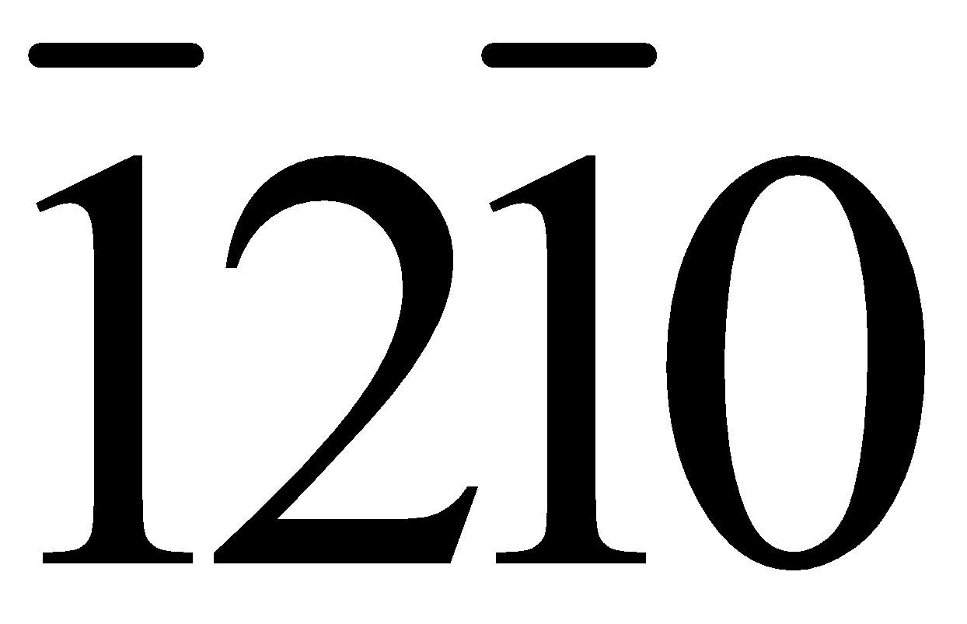
Crystallographic Planes continue.....
Hexagonal Crystal system
t = - (u’ + v’) u v t w =
e.g., t = -(0 + 1)
= -1 =
w = w’
Chapter 3: The Structure of Crystalline Solids
‹#›

Slide 26
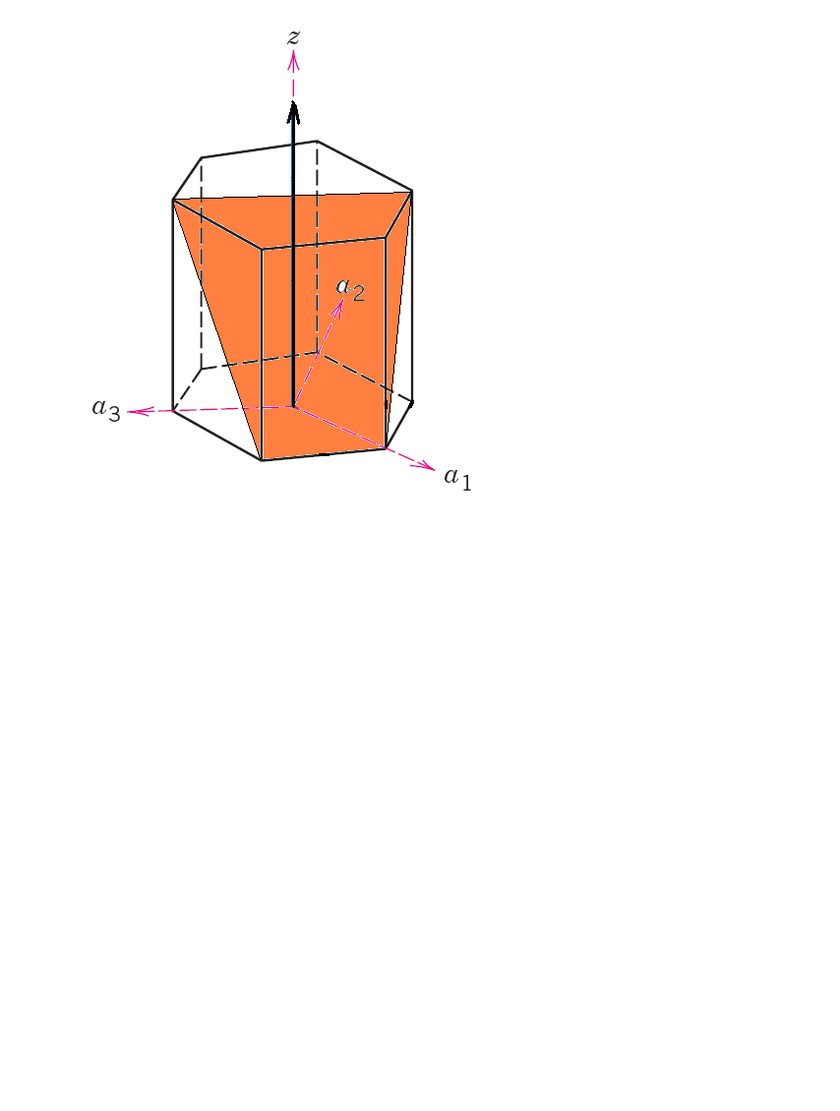
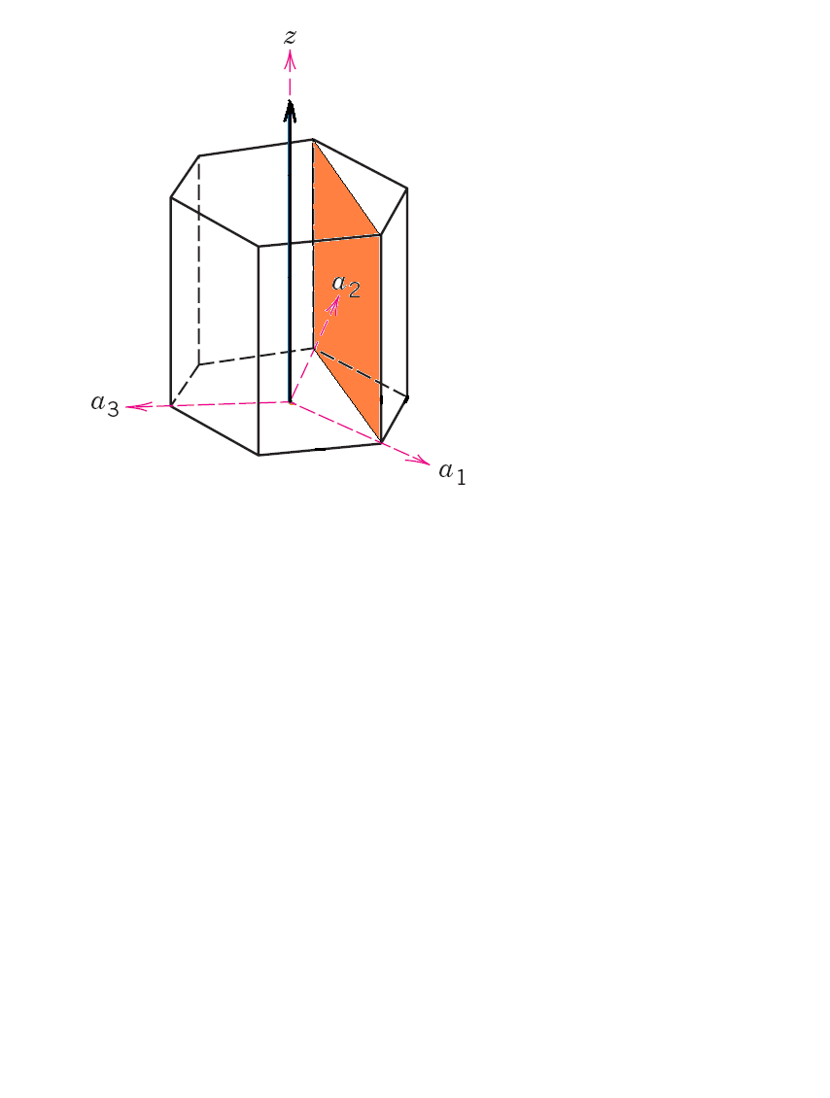
Crystallographic Planes continue.....
Hexagonal Crystal system
Chapter 3: The Structure of Crystalline Solids
‹#›

Slide 27
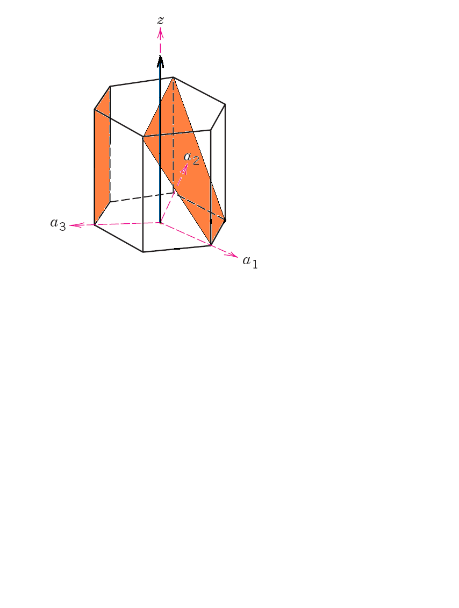
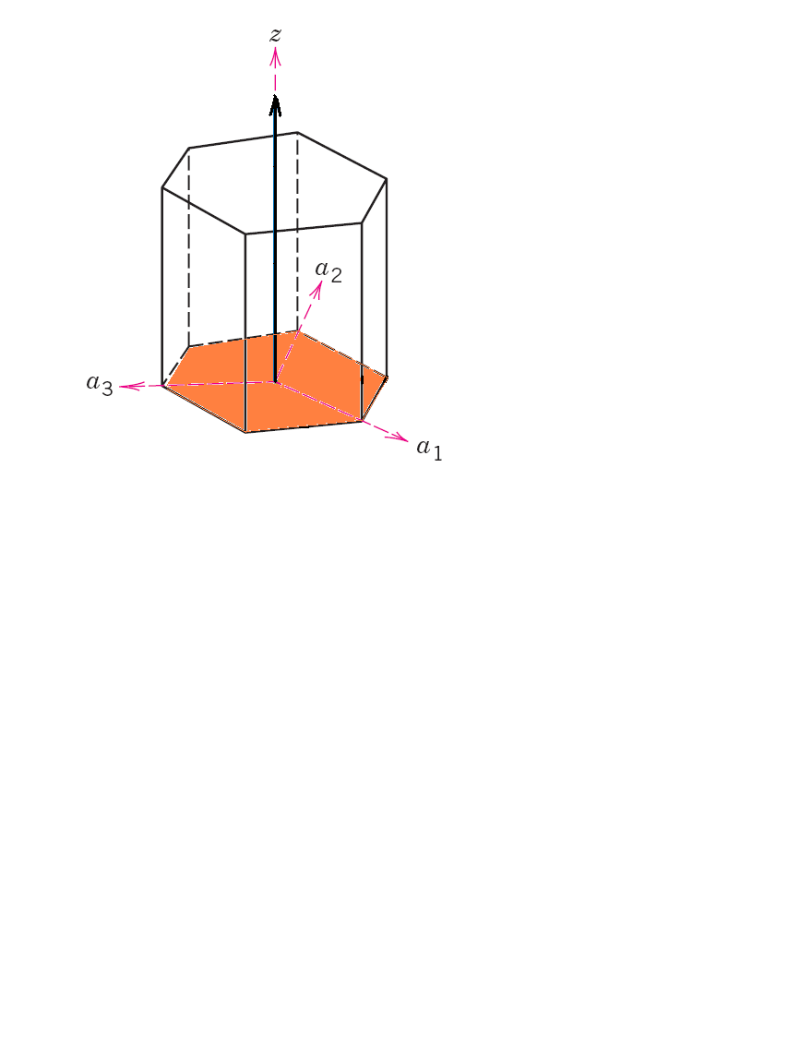
Crystallographic Planes continue.....
Hexagonal Crystal system
Chapter 3: The Structure of Crystalline Solids
‹#›

Slide 28
a₁, a₂, a₃ axes: all in basal plane (at 120° to each other)
Z-axis: Perpendicular to basal plane
[u’v’w’] -------> [u v t w]
a b c a b z c
Miller -------> Miller-Bravais
Crystallographic Planes continue.....
Hexagonal Crystal system
Chapter 3: The Structure of Crystalline Solids
‹#›

Slide 29
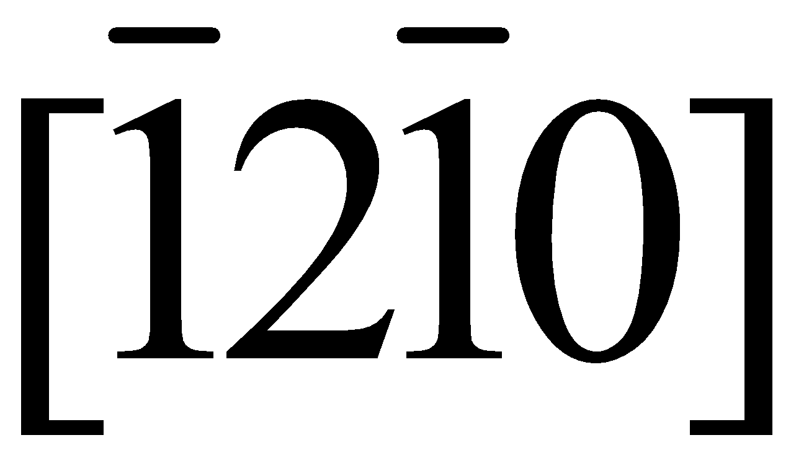
u = n/3 (2u’ – v’) [0 1 0] ------->
Crystallographic Planes continue.....
Hexagonal Crystal system
v = n/3 (2v’ – u’) u’v’w’ ----> u v t w
t = - (u’ + v’) u = (0 -1), t = -(1), v = 2, w = 0
w = nw’
n=factor to convert into indices
Chapter 3: The Structure of Crystalline Solids
‹#›

Slide 30
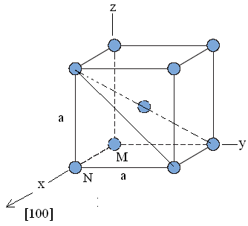
Linear and Planar Atomic Densities
Linear density
BCC
4R = a√3
a = 4R/√3
N
M
a√3
a
a√2
BCC LD [100] = [(Distance occupied)/ (distance available)] = (2R)/ a
= 2R/(4R/√2) = 0.866
Chapter 3: The Structure of Crystalline Solids
‹#›

Slide 31
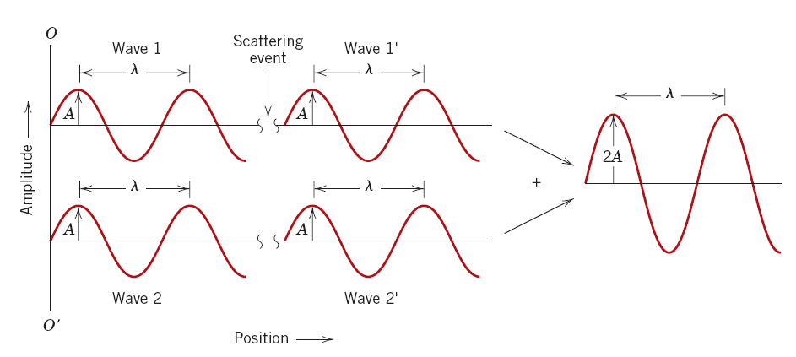
X- Ray Diffraction
In phase: reinforcement
Source: William D. Callister 7th edition, chapter 3 page 67
Chapter 3: The Structure of Crystalline Solids
‹#›

Slide 32
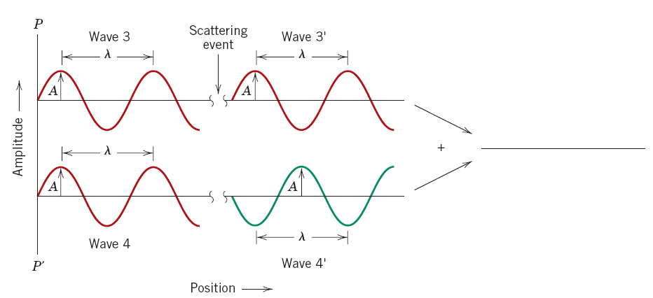
X- Ray Diffraction Continue…
Cancel
Source: William D. Callister 7th edition, chapter 3 page 67
Chapter 3: The Structure of Crystalline Solids
‹#›

Slide 33
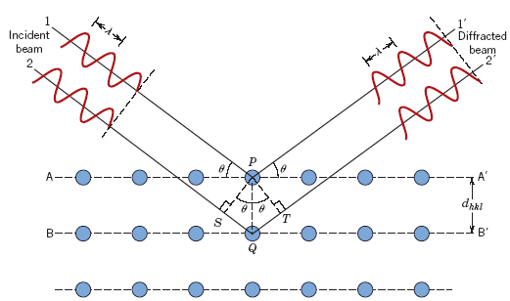
X- Ray Diffraction Continue…
Interplanar spacing
Source: William D. Callister 7th edition, chapter 3 page 67
Chapter 3: The Structure of Crystalline Solids
‹#›

Slide 34
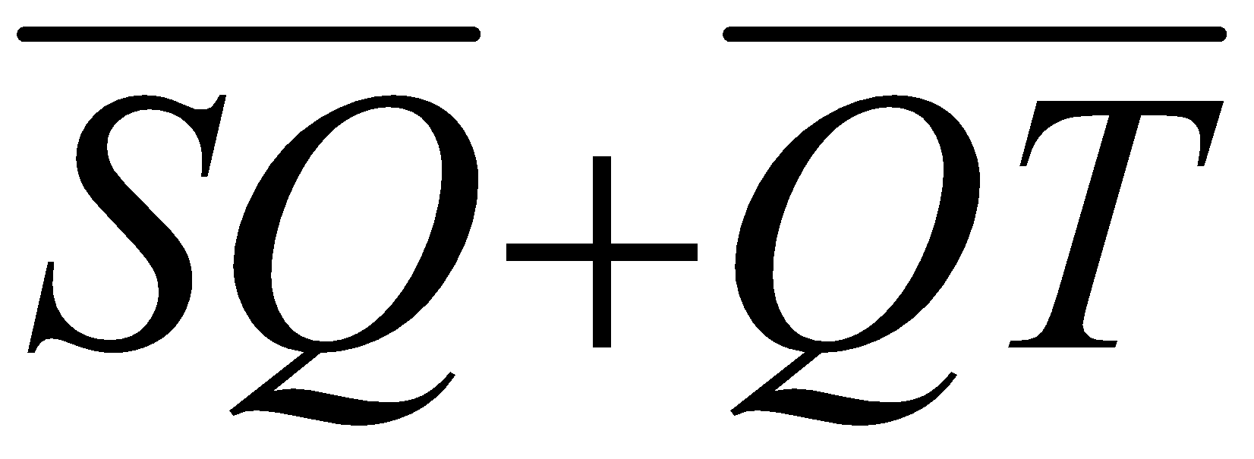
X- Ray Diffraction Continue…
nλ =
Where,
n = an integer, order of reflection
= 1 (unless stated otherwise)
Bragg’s law of diffraction
nλ = d_{hkl} sinθ + d_{hkl}sinθ
= 2d_{hkl} sinθ
Chapter 3: The Structure of Crystalline Solids
‹#›

Slide 35
X- Ray Diffraction Continue…
For cubic system,
a²/d² = h² + k² + l²
X-Ray Diffraction
nλ =
= path difference where n = integer = 1
= d_{hkl} sinθ + d_{hkl}sinθ
= 2d_{hkl} sinθ
a²/d² = h² + k² + l²
Chapter 3: The Structure of Crystalline Solids
‹#›

Slide 36
(h + k + l) must be even: BCC 2, 4, 6, 8, 10, 12……
h k l: all odd or all even FCC 3, 4, 8, 11, 12, 16……..
X- Ray Diffraction Continue…
If the ratio of the sin²θ values of the first two diffracting
planes is 0.75, it is FCC structure. If it is 0.5, it is BCC
structure
Chapter 3: The Structure of Crystalline Solids
‹#›

Slide 37
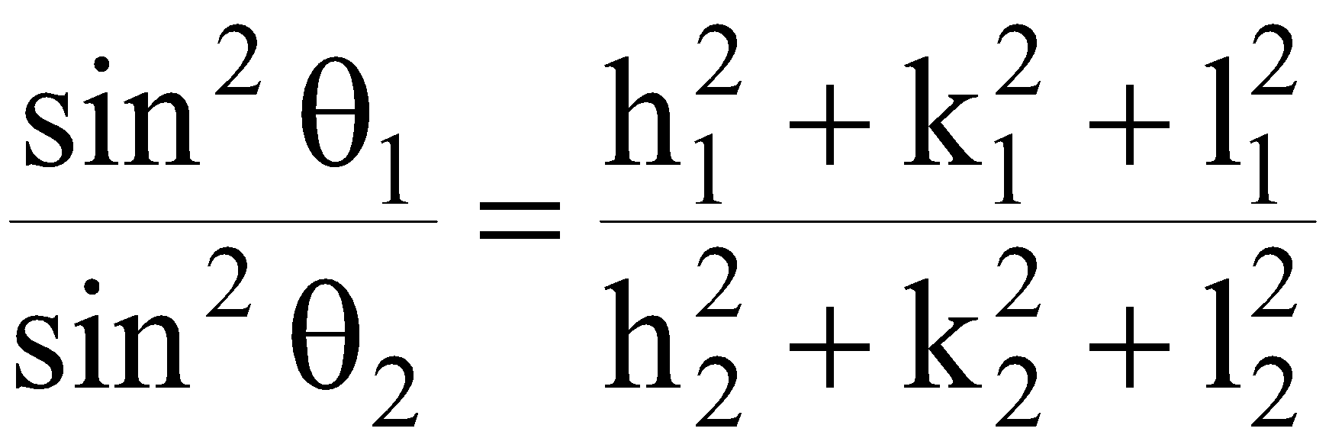
X- Ray Diffraction Continue…
λ = 2 d sinθ a²/d² = h² + k² + l²
λ = (2 a sinθ)/ √ (h² + k² + l²)
sin²θ = λ²(h² + k² + l²)/4a²
“ λ” and “a” are constants
Chapter 3: The Structure of Crystalline Solids
‹#›

Slide 38
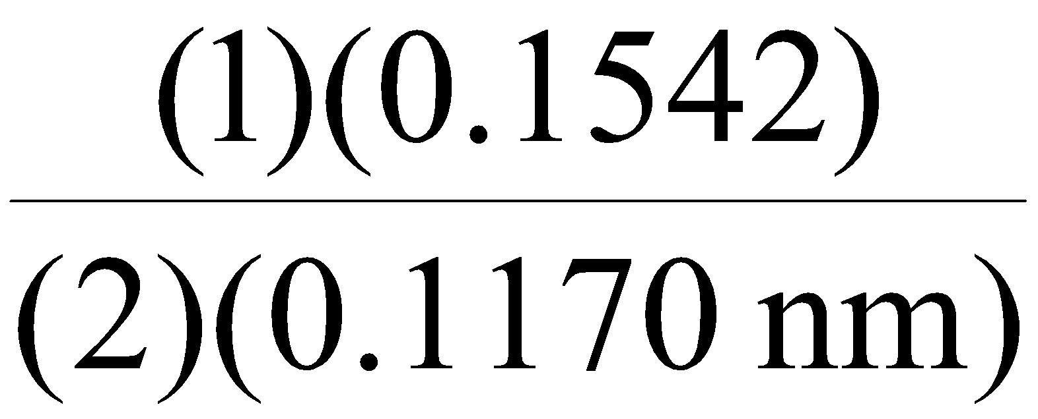
Problem:
Given: {211} Planes
a_{Fe} = 0.2866 nm (2.866Å)
λ = 0.1542 nm (1.542Å)
Determine d_{hkl}, 2θ (diffraction angle)
n = 1
d_{hkl} = a/ √ (h² + k² + l²)
= 0.2866 nm /√ (2² + 1² + 1²)
= 0.1170 nm (1.170Å)
n =1
sinθ = n λ/2d_{hkl} =
θ = sin⁻¹(0.659) = 41.22°
2θ = 82.44°
Chapter 3: The Structure of Crystalline Solids
‹#›

Slide 39
Crystalline and Non-crystalline materials
Single crystal: No grain boundary
Polycrystalline: Several crystals
Anisotropy: Directionality in properties
Isotropy: No directionality
Chapter 3: The Structure of Crystalline Solids
‹#›

Slide 40
Modulus of elasticity (E), psi x 10⁶ (MPa x 10³)
 |  | [100] | [110] | [111]
FCC | Al | 9.2 | 10.5 | 11.0
 |  | (63.7) | (72.6) | (76.1)
FCC | Cu | 9.7 | 18.9 | 27.7
 |  | (66.7) | (130.3) | (191.1)
BCC | Fe | 18.1 | 30.5 | 39.6
 |  | (125) | (210.5) | (272.7)
BCC | W | 55.8 | 55.8 | 55.8
 |  | (384.6) | (384.6) | (384.6)
Chapter 3: The Structure of Crystalline Solids
‹#›

Slide 41
Non-Crystalline
Amorphous
No systematic arrangement (regular) of atoms
Chapter 3: The Structure of Crystalline Solids
‹#›

Slide 42
Summary
Crystalline –lattice
Crystal system: BCC, FCC, HCP
Planes, directions, packing
X-Ray diffraction
Chapter 3: The Structure of Crystalline Solids
‹#›

Slide 43
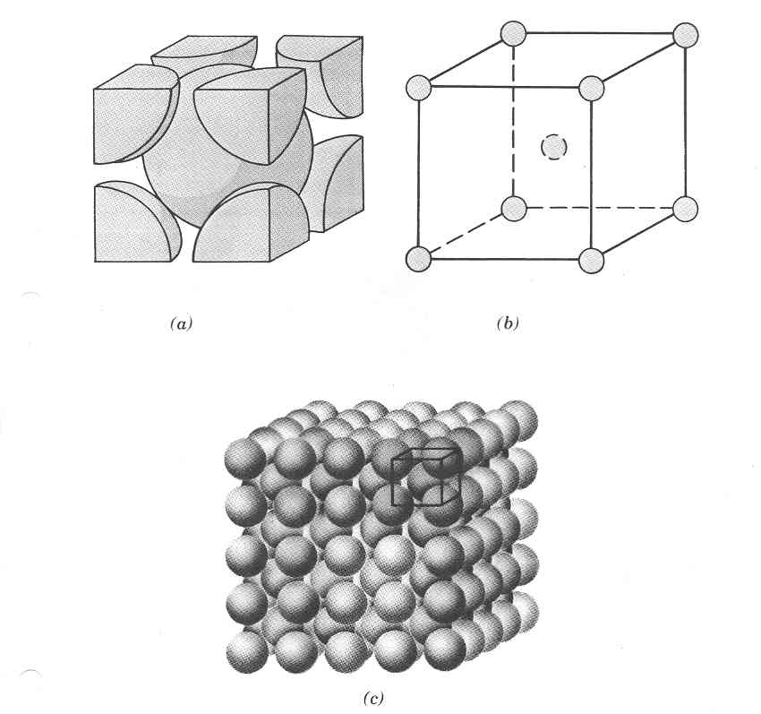
Source: Wiliam D. Callister 7th edition, chapter 3 page 42
Chapter 3: The Structure of Crystalline Solids
‹#›

Slide 44
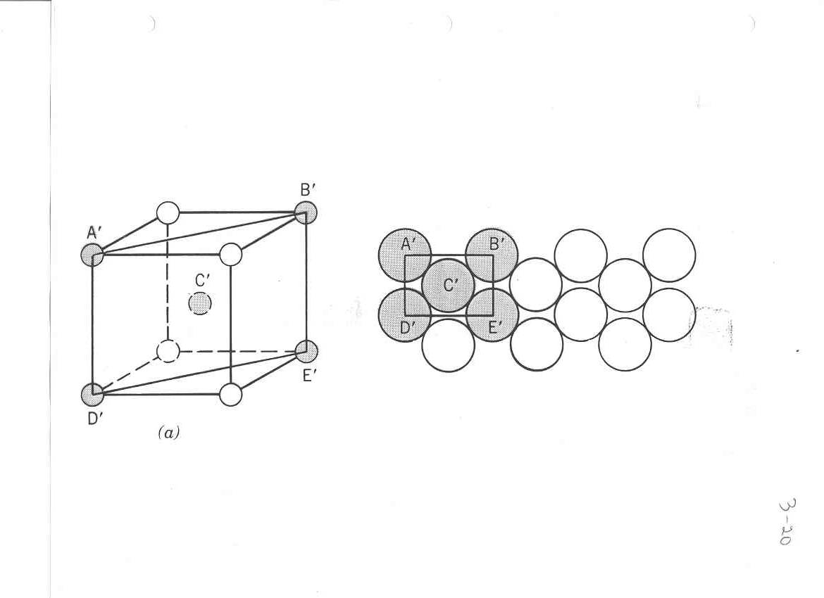
Source: William D. Callister 7th edition,
chapter 3 page 59
Chapter 3: The Structure of Crystalline Solids
‹#›

Slide 45
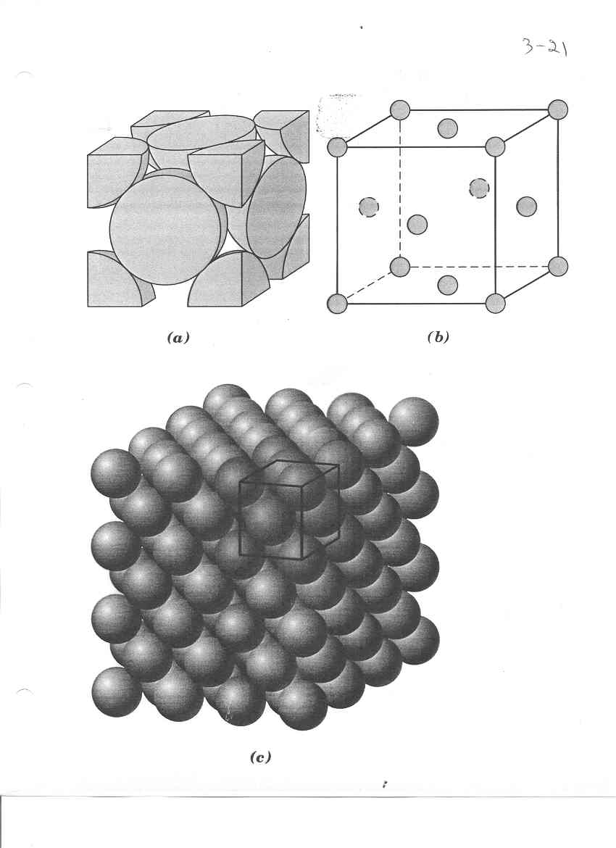
Source: William D. Callister 7th edition, chapter 3 page 40
Chapter 3: The Structure of Crystalline Solids
‹#›

Slide 46
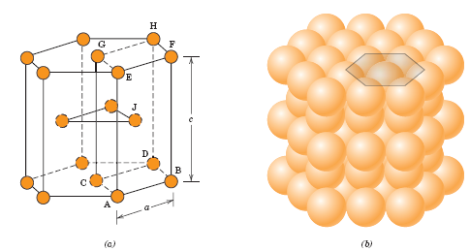
Source: William D. Callister 7th edition, chapter 3 page 43
Chapter 3: The Structure of Crystalline Solids
‹#›

Slide 47
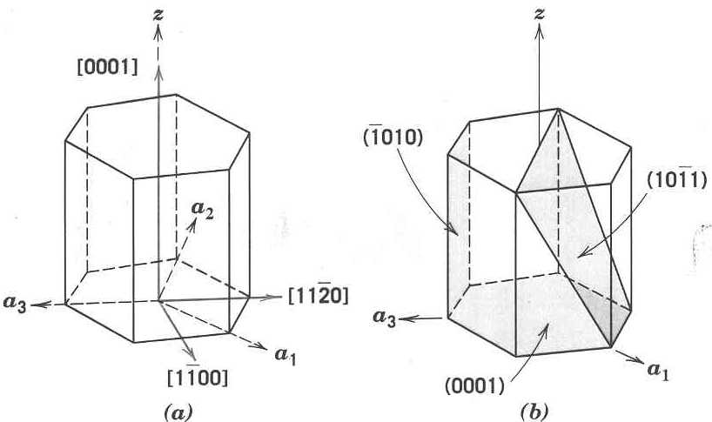
Source: William D. Callister 7th edition, chapter 3 page 54
Chapter 3: The Structure of Crystalline Solids
‹#›

Slide 48
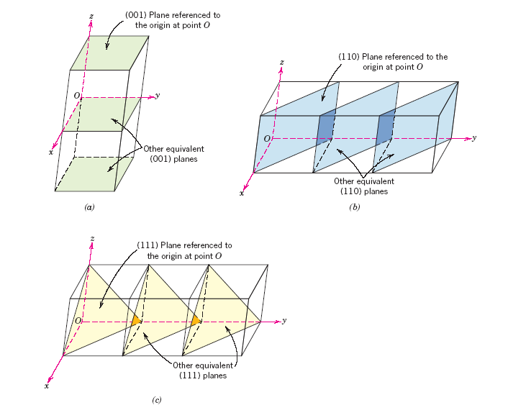
Source: William D. Callister 7th edition, chapter 3 page 57
Chapter 3: The Structure of Crystalline Solids
‹#›

